Slide 1

Session 9
Classes
and
Inline functions

Slide 2
Session Objectives (1)
Use the scope resolution operator
Use dynamic memory allocation with
  New
  Delete
Use pointers to objects
Define and use Constructors
Define and use Destructors
Define the "Const" keyword

Slide 3
Session Objectives (2)
Define and use the "this" pointer
Describe how objects and functions are arranged in memory
  Static Data Members
  Static member Functions
Describe type conversions using
  Converting by assignment
  Type casting
Explain Inline functions

Slide 4
Scope resolution operator (1)
Function can be defined outside the class specifier using a scope resolution operator (::).
  return_type class_name ::member_functions(arg1, arg2,. . ,argn)
Identifies the function as a member of a particular class.
Used to refer to global variable names in cases where a global variable and a local variable share the same name.
  ::global_variable

Slide 5
Scope resolution operator (2)
class sample{
.
.
.
public:
int sum(); // declaration of the function
};
int sample::sum()// definition of member function
{
. // code
.
return value of type int;
}

Slide 6
Dynamic memory allocation
An object is created when its definition appears in a program and it is destroyed when its name goes out of scope or the program terminates.
The keyword new - creates objects
The operator delete destroys objects.
Objects allocated by new and delete are said to be on the free store.

Slide 7
New (1)
The new operator is used to create a memory space for an object of a class
The general syntax of the new operator is:
data_type pointer_variable = new data_type;
int *p; //pointer to integer type
float *f; //pointer to a float type
p = new int; //allocates memory for an integer
f = new float; //allocates memory for a float

Slide 8
New (2)
If call to new is successful, it returns a pointer to the space that is allocated.
Returns zero if the space is not available or if some error is detected.
The new operator is similar to the malloc() function used in C.

Slide 9
Delete
Object created by new exists until it is explicitly destroyed using delete.
delete pointer_variable;
int *ptr;
ptr = new int;
*ptr = 12;
cout << *ptr;
delete ptr;

Slide 10
Allocating Arrays
int *ptr;
ptr = new int[100];
delete [] ptr;
When you allocate an array of objects using new, you must use [] in the delete statement.
Trying to delete a variable that has been allocated using malloc and trying free a variable that was allocated with new will generate an error.

Slide 11
Pointers to objects (1)
Pointers can point to objects as well as to simple data types.
Declaring a pointer to an object of a particular class is the same as declaring a pointer to a variable of any data type.

Slide 12
Pointers to objects (2)
date *today_ptr;
  //pointer to an object of type date
  today_ptr = new date;
  //points to the new date object
To access a method of the object use the arrow (->) operator.
  today_ptr->getdate();

Slide 13
Constructors (1)
A constructor is a special member function for automatic initialisation of an object.
Has the same name as the class it belongs to.
Can be declared and defined within the class, or can be declared within the class and defined outside the class.
No return type is used for constructors.

Slide 14
Constructors (2)
    class username {
    public:
    username(); //constructor
    };
    username::username() { }
You can have more than one constructor.
In case of multiple constructors, the types of the arguments or the number of arguments should differ.
date now;
date today(4);
date all(23,3,1998);

Slide 15
Constructors (3)
class date{
int month, day, year;
public:
date() //default constructor
{day=1; month=1; year=1999;}
date(int x) //only day is specified
{day=x; month=1; year=1999;}
date(int x, int y, int z) //day month year
{day=x; month=y; year=z;}
};

Slide 16
Destructors
A destructor is a member function that is called automatically when an object is destroyed.
Cannot be directly called from the class. The compiler itself generates a call to a destructor when an object expires.
Same name as the class but with a tilde (~) before the class name.
  class username {
  public:
  ~username(); //destructor
  };
Destructors have no return type and they take no arguments.

Slide 17
De-allocate memory with delete
Destructors are used to de-allocate memory that was allocated for the object by the constructor.
  class String{
  private:
  char *str;
  public:
  String(char *s){ //constructor
  int length = strlen(s);
  str = new char[length+1];
  strcpy(str,s);
  }
  ~String() {delete[] str;} //destructor
  };

Slide 18
The Const keyword
A constant is an entity whose value does not change during the execution of a program.
The keyword const is used to declare a constant.
A constant cannot be assigned to, so it must be initialised.
  const int num=100;
  num=200; //error
  num++; //error

Slide 19
Const with pointers (1)
When we use const with a pointer, there are two objects involved - the pointer and the object pointed to.
Prefixing a declaration of a pointer with const makes the object, but not the pointer, a constant. int num =10;
  const int *iptr = &num;
  *iptr = 25; //error
  num = 25; //valid, num is not constant
  int xyz = 200;
  iptr = &xyz; //iptr can point anywhere else
  *iptr = 305; //error

Slide 20
Const with pointers (2)
It is possible to declare a pointer itself as a constant using the *const operator.
  int a1 = 777; //constant pointer to integer
  int *const ptr = &a1;
  *ptr = 66; //valid
  int a2 = 45;
  ptr = &a2; //error, ptr is a constant

Slide 21
Const with pointers (3)
The const keyword can also be used in parameter lists.
  void func(const char *str)
  {
  str = "hello"; //valid
  *str = 'A'; //error
  }
  void func1(const int index)
  { index = 5;} //error

Slide 22
The this pointer (1)
Keyword this gives the address of the object, which was used to invoke the member function.
Whenever a member function is called, the compiler assigns the address of the object, which invoked the function, to the this pointer.
Can be used like any other pointer to an object.
Can be used to access the members of the object it points to using the arrow operator.
  this->age = 5;
  this->getdata();

Slide 23
The this pointer (2)
class Person{
private:
int age;
public:
void display();
};
void Person :: display()
{ this->age = 25; // same as age=25
cout<<this->age; // same as cout<<age
}
void main()
{ Person Jack;
Jack.display();
}

Slide 24
Objects and functions in memory (1)
Each object has its own copy of the data members of the class.
The member functions are created and placed in memory only once - when they are defined in the class specifier.

Slide 25
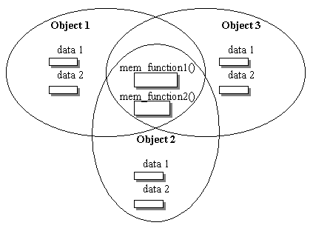
Objects and functions in memory (2)

Slide 26
Static Data Members (1)
Useful when all objects of the same class must share a common item of information.
If a data item in a class is defined as static, then only one such item is created for the entire class, no matter how many objects there are.
Only visible within the class, but its lifetime is through the entire program.
static data_type variable;

Slide 27
Static Data Members (2)
class race_cars{
private:
static int count:
int car_number;
char name[30];
public:
race_cars(){count++;}
~race_cars(){count--;}
};
int race_cars::count;
The static data member should be created and initialised before the main() program begins.

Slide 28
More on Static Data members
Access rules are same as for other data members.
If declared as private, the non-member functions cannot access it.
If declared as public, then any member of the class can access.
Static member can become a global data for the class.

Slide 29
Static Member Functions (1)
A static member function can manipulate only on the static data member of the class.
Acts as global for members of its class without affecting the rest of the program.
It is not part of the objects of a class. It does not have a this pointer.

Slide 30
Static Member Functions (2)
  class alpha{
  private:
  static int count; //static data member
  public:
  alpha(){count++;} //constructor increments
  //count
  static void display_count() //static member
  // function
  { cout<<count; }
  };

Slide 31
Static Member Functions (3)
  void main()
  {
  alpha::display_count(); //before any object //is created
  alpha obj1, obj2, obj3;
  alpha::display_count(); //after three //objects created
  }
Even when no object has been created we can directly call the static member using the name of the class and the scope-resolution operator
alpha::display_count();

Slide 32
Inline Functions (1)
When a compiler sees a function call, it jumps to the function. At the end of the function it goes back to the instruction following the function call.
To save execution time in short functions use inline functions
An inline function is written just like a normal function in the source file but compiles into inline code instead of into a function.
inline float converter(float dollars);

Slide 33
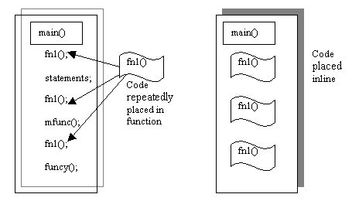
Inline Functions (2)

Slide 34
Inline Functions (3)
Very short functions suitable for inlining
Shown as a separate entity in source file but when program is compiled, the function body is inserted into the program wherever a function call occurs.
When you define an inline function for an application that involves different source files, you should not give different implementations of the inline member function in different source files.

